Slide 1
Location and Handoff Management
Module 2

Slide 2
Location Management
LM consists mainly of:
Location Tracking and Updating (Registration): A process in which an end-point initiates a change in the Location Database according to its new location.
This procedure allows the main system to keep track of a user's location so that for example an incoming call could be forwarded to the intended mobile user when a call exists or maybe bring a user's profile near to its current location so that it could provide a user with his/her subscribed services.
Location Finding (Paging): The process of which the network initiates a query for an end-point's location.
This process is implemented by the system sending beacons to all cells so that one of the cells could locate the user. This might also result in an update to the location register.

Slide 3
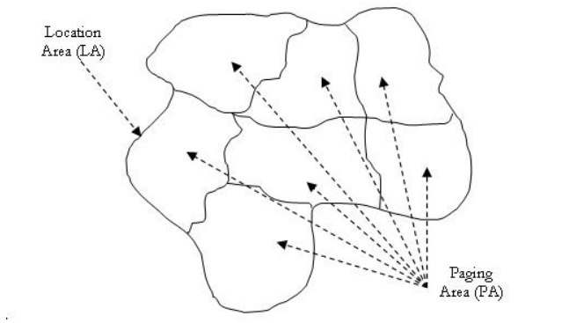
Concept of LA and PA

Slide 4
Location Management
Cells in a network are grouped into Location Areas (LAs).
Users can move within these LAs, updating their location with the network based upon some predefined standard.
When a user receives a call, the network must page cells within the LA (also referred to as polling) to find that user as quickly as possible.
frequent Location Updates (LUs) to reduce polling costs by incurring increased time and energy expenditures from all the updates
only require rare LUs, storing less information about users to reduce computational overhead, but at a higher polling cost

Slide 5
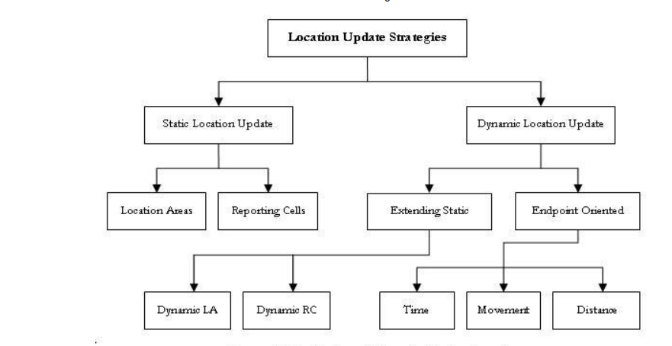
Location Update Strategies

Slide 6
Issues in Location Management
database architecture design
transmission of signaling between various components of a signaling network
security, dynamic database updates
querying delays
terminal paging methods
paging delays

Slide 7
LM Schemes
Without Location Management
1. Is referred to as the Level 0 method.
2. The system doesn't track any mobile devices.
3. Searching for a user is done over the complete radio coverage area and within a specific time limit.
4. Is also referred to as the Flooding Algorithm.
5. It is used in paging
6. advantage-it is simple to implement because of the absence of a special database.
7disadvantage- is that it doesn't fit into large networks dealing with high number of users and high incoming data exchange rates.
Manual Registration in Location Management
1. Is referred to as the Level 1 method.
2. The system is simple to manage because it only requires the management of an indicator which stores the current location of the user.
3. The mobile is relatively simple since its task is limited to scanning the channels to detect paging messages. An example of such a system is telepoint cordless systems.
4. The main disadvantage of this method is that users have to re-register each time they move.

Slide 8
LM Schemes
Automatic Location Management using LAs
1. Is referred to as the Level 2 method.
2. Widely used and deployed in 1G and 2G cellular systems.
3. Since this method is a LA based method, a home database and several visitor databases are included in the network architecture.
Memoryless-Based Location Management Methods
These methods depend mainly on the processing capabilities of the system. They are based on algorithms and the network architecture.
Memory-Based Location Management Methods
The design of memory-based location management methods has been motivated by the fact that systems perform many repetitive actions which can be avoided
if predicted.
Location Management in Next Generation Systems
The next generation in mobility management will enable different mobile networks to interoperate with each other to ensure terminal and personal mobility and
global portability of network services. However, in order to ensure global mobility, the deployment and integration of both wired and wireless components is necessary.
These future systems will all depend on the usages of Mobile IP. For example, the aim of 4G cellular networks is to deploy Mobile IP in its infrastructure so that users can switch between different access technologies.

Slide 9
Static Location Management
most LM schemes are static, where LUs occur on either periodic intervals or upon every cell change.
static LAs incur great costs with the ping-pong effect.
When users repetitively move between two or more LAs, updates are continuously performed unnecessarily
cells are constant in size, uniform, and identical for each user
Three simple static Location Update schemes
being always-update : involves the user updating its location upon every inter-cell movement
never-update : never require the user to inform the network of intercell movements, only updating on LA changes, and is named never-update
static interval-based - each user within the network to update at static, uniform intervals.

Slide 10
Static Location Update Scheme
being always-update : involves the user updating its location upon every inter-cell movement
Limitations -
incur significant energy and computational costs to both the network and the user,
may be particularly wasteful, as if a user makes frequent, quick movements within an LA,
beginning and ending at the same location, many LUs will occur that might be unnecessary, especially if few or no calls are incoming.
Advantage -
network will always quickly locate a user upon an incoming call, and extensive paging will not be necessary.

Slide 11
Static Location Update Scheme
never-update : never require the user to inform the network of inter-cell movements, only updating on LA changes, and is named never-update
Limitations
resources are saved as constant updates are not required, but paging costs rise substantially
every cell within the user’s LA may need to be checked during paging due to the lack of information, which causes excessive overhead for users with a high incoming call frequency.

Slide 12
Static Location Update Scheme
static interval-based - each user within the network to update at static, uniform intervals.
balance between the extremes of the previous schemes, as the network will neither be overwhelmed with LUs nor wholly unaware of users’ locations.
Limitation-
users with rapid rates of movement may move into new LAs between updates, which causes locating that user to be very difficult.
an inactive user will not move at all, but will still regularly be sending unneeded LUs.

Slide 13
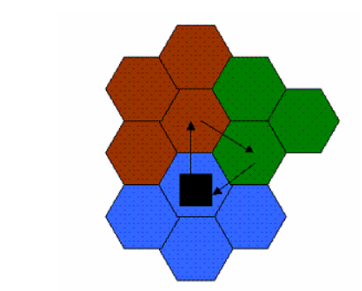
Static Location Areas
Location Areas in static LM are static.
They are effectively the easiest solution to physically dividing a network, providing the same LA to every user, without any customization.
static LAs are set and cannot change
If users repetitively move between two or more adjacent LAs, will cause a large number of LUs with a small or zero absolute cell distance moved.

Slide 14
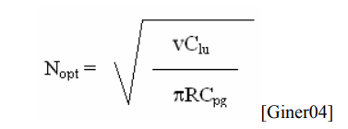
Optimal LA size static Algorithm
Fluid model: This model assumes traffic flow to be like the flow of a fluid. The amount of traffic flowing out of an area is proportional to the population density of the area, the average velocity of movement, and the length of the area boundary.
The optimal static LA size algorithm, which uses a Fluid-Flow mobility model, states that in a network with uniform cell size, cell shape, and user movement speed, the ideal number of cells per LA is-
where R is the cell radius, v is the speed of a user, Clu is the LU cost, and Cpg is the paging cost per call.
This equation states that high user speed and LU costs indicate that having a large number of cells per LA is preferable, while a large cell radius and high paging costs imply that a small number of cells per LA is optimal.

Slide 15
Static LM Standards/Implementation
In current cellular telephone usage,
the Electronic and Telephone Industry Associations (EIA/TIA) Interim Standard IS-41, and the Global System for Mobile Communications (GSM) Mobile Application Part (MAP).
Both of these are quite similar, having two main tasks of Location Update and Call Delivery.

Slide 16
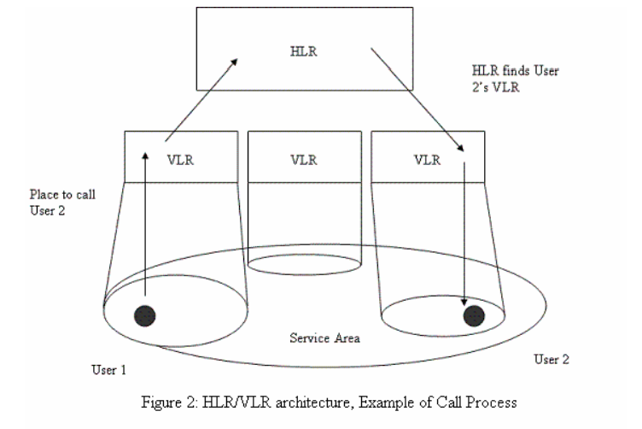
Two level hierarchical database scheme
The Home Location Register (HLR) contains the records of all users’ services, in addition to location information for an entire network.
Visitor Location Registers (VLRs) download data from the HLR concerning current users within the VLR’s specific service areas.
Each LA has one VLR servicing it, and each VLR is designed to only monitor one LA.
each VLR is connected to multiple Mobile Switching Centers (MSCs), which operate in the transport network in order to aid in handoffs and to locate users.

Slide 17
Communication on a call
All inter-cell movements cause an update to the VLR, while the HLR does not need any modification, as both the MSC and VLR that the user resides in remains constant.
Inter-MSC movements within the same LA cause the VLR to be updated with the new cell address, and also cause an update to the HLR to modify the stored value of the user's MSC.
Finally, Inter-VLR movements cause the new VLR to create a record for the user, as well as causing an update to the HLR where both MSC and VLR fields are updated.
After this occurs, the old VLR's record for the user is removed. Figure 2 displays a symbolic high-level view of the HLR/VLR architecture, as well as demonstrating the methods of communication on a call.

Slide 18
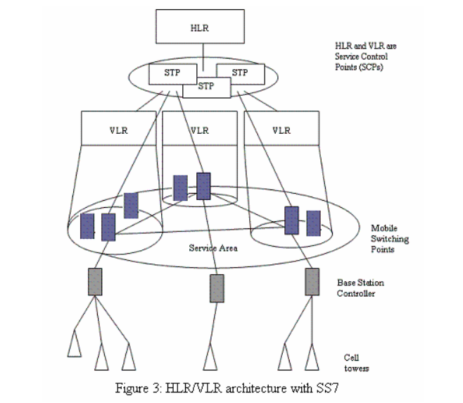
Call Delivery with the help of SS7
System database is queried to determine the LA or registration area of the user.
This is split into two steps; a fixed network interrogation is performed to find a region of cells containing the target, in which the HLR is queried to obtain the VLR of the called user.
Next, paging is used to poll cells within this region until the user is found.
Currently, a system called Signaling System 7 (SS7) is used to transmit these locating messages.
In this system, Signal Transfer Points (STPs) route messages through the network (as the HLR), while Service Control Points (SCPs) maintain the databases and information (as VLRs), and Service Switching Points (SSPs) help route calls (as MSCs).

Slide 19
Location Management Parameters
1. Paging
Simultaneous Paging-
every cell in the user’s LA is paged at the same time in order to find the user
Quicker
Cost wise inefficient
Sequential Paging-each cell within an LA is paged in succession
poll the cells nearest to the cell of the most recent LU, and then continue outward if the user is not immediately found.
Intelligent Paging
calculates specific paging areas to sequentially poll based upon a probability matrix.
optimized version of Sequential Paging
2. Mobility Models

Slide 20
Mobility Models for Individual Node Movements
Mobility Model is a model that describe the movement of mobile users and how their location, velocity and acceleration change over time.
The mobility metrics usually speaks about the mobility patterns.
These include spatial dependence, temporal dependence, relative speed and geographic restrictions.
Random Walk
Markov
Fluid Flow
Activity Based

Slide 21
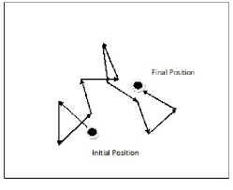
Mobility Models for Individual Node Movements
Random Walk is a part of Indoor Mobility Models.
Indoor Mobility model, there are 3 parts- Random Walk, Random Way-Point, Random Direction.
2D Random Walk is widely used in mobility.
It is memory-less mobility pattern.
Current speed is independent of its past.
This also generates unrealistic movements such as sudden stops and sharp turns.

Slide 22
Mobility Models for Individual Node Movements
Gauss-Markov mobility model – Outdoor mobility model
Probabilistic version of Random walk
The model adapts to different levels of randomness.
In indoor mobility models, there are fixed simulation areas in which we can do whether random walk or random way-point or random direction.
In outdoor mobility model, there is no concept of the simulation area. It is purely random.
each mobile node is assigned a current speed and direction. It means that every node has its initial direction and initial speed and it can change itself randomly. It can move freely in and out.
The Gauss Markov model has both memory and variability.
The tunable alpha parameter determines how much memory and randomness you want to model.

Slide 23
Mobility Models for Individual Node Movements
Fluid Flow model - modelling users as a fluid; free particle (pedestrian) flow and the continuum (large crowd) flow approach
use of fluid mechanics and transport theory to represent user mobility.
A model based on viscous free irrotational fluid mechanics
Empirical data from pedestrian and vehicular studies provide a means of creating realistic group movement characteristics with smooth non random trajectories and smooth continuous velocity.
The model is used in an example to provide boundary crossing rates for users in a cellular network and optimising the size of cellular location areas.
Notes:
Considers network as a whole, other models considers each user.

Slide 24
Mobility Models for Individual Node Movements
Activity Based Model – Extension of Markovian model
parameters such as time of day, current location, and predicted destination are also stored and evaluated to create movement probabilities.
a mobility model was developed with the goal of providing realistic mobility patterns for individual subscribers.
The model is based on activity pattern theory borrowed from related work in traffic engineering and social science, and using raw data from regional planning travel surveys.
The principle behind the model is that, through statistics derived from travel surveys, there are certain probabilities associated with one activity following another activity, based on certain parameters such as time of day and socioeconomic status.

Slide 25
Group based LM
It is based on the assumption that the number of high cost location update messages from mobile hosts to the location server can be reduced by clustering mobile hosts with similar mobility into a set of groups.
A single location report for the whole group is sent to the location server
A leader will be selected to perform location updating on behalf of the whole group to the moving object database.
positive consequence is that mobile hosts no longer need to possess the long range communication capability with the remote server; location information can be reported via the group leader.

Slide 26
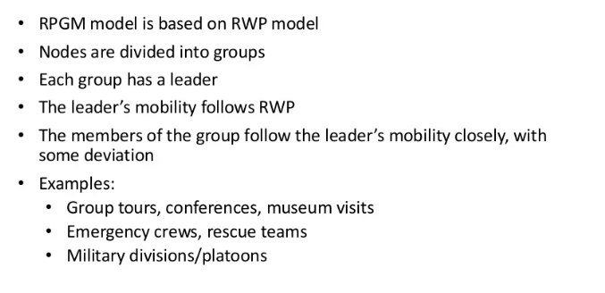
Mobility models characterizing the movement of groups of nodes
1. Reference point based group mobility model

Slide 27
Mobility models characterizing the movement of groups of nodes
2. Community based group mobility model
mobility model based on social network theory.
each community is defined as a group of nodes that have strong social links with each other, and consequently a likelihood of being co-located together
An interactionmatrix (IM) where each element has a value ranging from 0 to 1 (low to high) is used torepresent the degree of social interaction between any two nodes.
the highly connected set of nodes will be grouped together to form a community.
movements of the nodesare also influenced by the social links between them. A node will move to a randomlyselected location within a community
(PDF) A Review of Group Mobility Models for Mobile Ad Hoc Networks. Available from: https://www.researchgate.net/publication/282535731_A_Review_of_Group_Mobility_Models_for_Mobile_Ad_Hoc_Networks [accessed Aug 07 2022].

Slide 28
Design Features of Group Mobility Models
Spatial constraints: These refer to constraints imposed by the nodes’ spatial environment that restrict their movements in a certain way. Such constraints may include roads, walkways, rail tracks, and transportation structures such as bridges andtunnels
Collision avoidance: This refers to controlling the movement of a node to avoid physical collision with other nodes. GFMM introduces repulsion force between neighboring nodes to achieve this goal.
Stable group structure: This refers to maintaining the relative distances and positions among the group members during a group movement, such as when a group of nodes(e.g. troops, tanks, robots) move in formation, or on-board a transport carriage (e.g.bus, truck, train).

Slide 29
Design Features of Group Mobility Models
Group destination: This refers to the target destination of a moving group, which can be randomly chosen or predefined.
Group coordination: This refers to the existence of some cooperation or interaction among groups, which allows the movement of these groups to be coordinated. Such coordination exists in real-life scenarios such as that exhibited between groups when moving through a road traffic intersection.

Slide 30
Dynamic Location Management
Dynamic location update schemes allow per-user parameterisation of the location update frequency.
account for the dynamic behaviour of users and may result in lower location management costs than static schemes.
Unlike static location management strategies, a location update may be performed from any cell in the network, taking into consideration the call arrival and mobility patterns of the user.

Slide 31
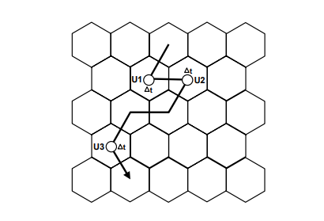
1. Time-based Update
users update their location at constant time intervals.
time interval be optimised per-user, to minimise the number of redundant update messages sent.
requires the mobile device to maintain a simple timer, allowing efficient implementation and low computational overhead.
a high degree of overhead
when a user has only moved a very small distance or
has not moved at all

Slide 32
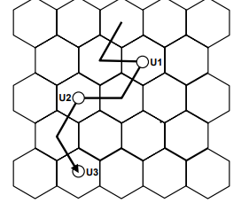
2. Movement-based Update
mobile devices update their location after a given number of boundary-crossings to other cells in the network.
optimised for individual movement and call arrival rates
device updates its location every two crossings between cells
The required paging area is restricted to a neighborhood of radius equal to the distance threshold around the last updated location.
The paging area requirement is reduced through this scheme,
although unnecessary updates may still be performed as a result of repeated crossings over the same cell boundary.

Slide 33
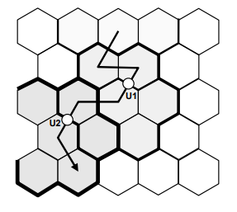
3. Distance-based Update
mobile device performs a location update when it has moved a certain distance from the cell where it last updated its location.
not requiring an update when a user repeatedly moves between a small subset of cells, provided these cells reside within the distance-threshold radius
quite difficult to implement in a real-world network
coordinate system is a non-trivial requirement in a heterogeneous network, where cell adjacencies and distances may not be clearly defined.
Notes:
Coordinate system is required to calculate distance

Slide 34
4. Profile-based
the network maintains a profile for each user in the network, based on previous movements, containing a list of the most probable cells for the user to reside within.
On a location update the network sends this list to the mobile device, forming what may be considered a complex location area.
The mobile device updates its location only when entering a cell not contained in the list.
high overhead of sending a large cell list to users outweighs the cost reduction provided by the profile-based scheme.

Slide 35
Adaptive
predictive distance-based update scheme –
predicts a mobile’s future location based on the location and velocity information registered during an update.
The shape of the assigned location area reflects the mobility patterns of the user, while the size of the area varies as a function of the incoming call rate.
activity-based location update scheme –
The frequency of each cell movement between adjacent cells is measured along with the residence time at each cell
likelihood of residence in each cell is evaluated, with each cell added in decreasing probability order until the maximum location area size is reached

Slide 36
Terminal Paging
mobile devices perform updates according to their location update scheme,
the network needs to be able to precisely determine the current cell location of a user to be able to route an incoming call.
This requires the network to send a paging query to all cells where the mobile device may be located, to inform it of the incoming transmission.
Simultaneous paging
Sequential paging
Intelligent Paging

Slide 37
Simultaneous paging (blanket paging)
used in current GSM network implementations
all cells in the users location area are paged simultaneously, to determine the location of the mobile device.
requires no additional knowledge of user location but may generate excessive amounts of paging traffic
Implementations of simultaneous paging favour networks with large cells and low user population and call rates.
Not favorable in large networks

Slide 38
Sequential Paging
Sequential paging avoids paging every cell within a location area by segmenting it into a number of paging areas, to be polled one-by-one.
The number of cells per paging area is a factor which needs to be optimised and may lead to excessive call delays, particularly in large networks.
several methods to determine the ordering of paging areas in a sequential scheme.
Purely random
paging areas located geographically closer to the previously updated location are found to further reduce the total number of paging messages required

Slide 39
Intelligent Paging
a variation of sequential paging, where the paging order is calculated probabilistically based on pre-established probability metrics
s efficient ordering of paging areas requires a comprehensive knowledge of user residence probabilities.

Slide 40
Basics of Mobile IP - Terminology
Mobile Node (MN)
system (node) that can change the point of connection to the network without changing its IP address
Home Agent (HA)
system in the home network of the MN, typically a router
registers the location of the MN, tunnels IP datagrams to the COA
Foreign Agent (FA)
system in the current foreign network of the MN, typically a router
forwards the tunneled datagrams to the MN, typically also the default router for the
MN
Care-of Address (COA)
address of the current tunnel end-point for the MN (at FA or MN)
actual location of the MN from an IP point of view can be chosen, e.g., via DHCP
Correspondent Node (CN)
communication partner

Slide 41

Example network
HA
MN
Internet
router
home network
mobile end-system
(physical home network
for the MN)
FA
foreign network
router
(current physical network for the MN)
CN
end-system
router

Slide 42
Data transfer to the mobile system
HA
2
MN
Internet
home network
3
receiver
FA
foreign
network
1. Sender sends to the IP address of MN,
HA intercepts packet (proxy ARP)
2. HA tunnels packet to COA, here FA,
by encapsulation
3. FA forwards the packet to the MN
1
CN
sender

Slide 43
Data transfer from the mobile system
HA
1
MN
Internet
home network
sender
FA
foreign network
1. Sender sends to the IP address of the receiver as usual, FA works as default router
CN
receiver

Slide 44
Overview
COA
foreign
network
home
network
router
HA
router
FA
MN
Internet
CN
router
3.
foreign
network
home
network
router
HA
router
FA
MN
2.
4.
Internet
1.
CN
router
Packet Delivery to and from the mobile node

Slide 45
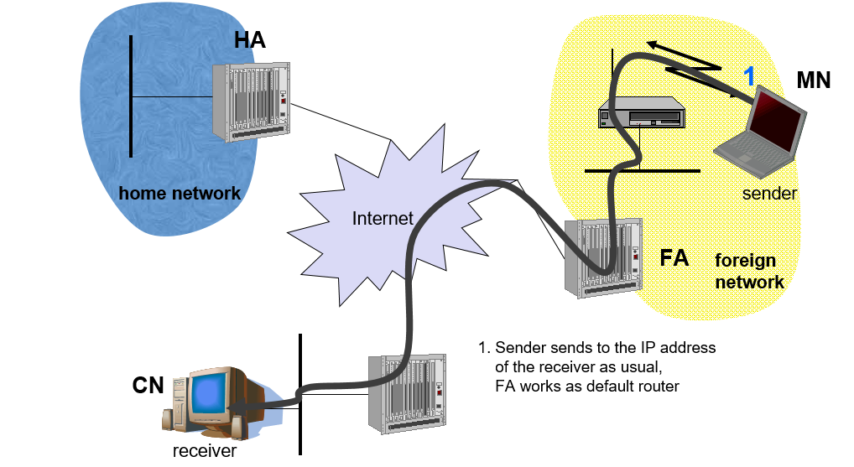
Reverse Tunneling
Problems Associated:
Firewalls: firewalls only allow packets with topologically correct addresses to pass. This provides at least a first and simple protection against misconfigured systems of unknown addresses.
Multi-cast: Reverse tunnels are needed for the MN to participate in a multicast group.
TTL:The TTL might be low enough so that no packet is transmitted outside a certain region.
Solution
Reverse tunneling now creates a triangular routing problem in the reverse direction. All packets from an MN to a CN go through the HA.

Slide 46
Location management and Mobile IP
Mobile IP is a common standard to support global mobility of mobile hosts
major problems for the Mobile IP is frequent location update and high signaling overhead
To solve this problem, a regional registration scheme was proposed to employ the hierarchy of the foreign agents (FAs) and the gateway foreign agents (GFAs) to localize registration operation.
hierarchical IPv6 addressing for LM and uses specialized mechanisms for handoff management. It eliminates packet redirection along correspondent node (CN) - mobile node (MN) path, rendering greater scalability and simplifying routing.
a Hierarchical Mobile IPv6 (HMIPv6) scheme to improve the performance capability of Mobile IPv6 at handover. In HMIPv6, local entities named Mobility Anchor Points (MAPs) are distributed throughout a network to localize the management of intra-domain mobility

Slide 47
Handoff Management
Overview of handoff process;
Factors affecting handoffs and performance evaluation metrics; Handoff strategies;
Different types of handoffs (soft, hard, horizontal, vertical)
https://www.youtube.com/watch?v=vJcyC1tJvD0

Slide 48
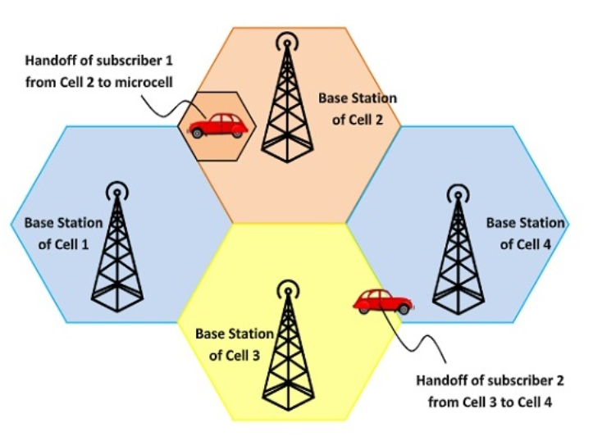
Handoff Process
The term “handover” or “handoff” as used in the context of mobile or cellular phone systems would be more appropriate as it is simply a change of the active cell.
Prevents loss of interruption of service.

Slide 49
Handoff Scenarios
If a subscriber who is in a call or a data session moves out of coverage of one cell and enters coverage area of another cell, a handoff is triggered for a continuum of service. The tasks that were being performed by the first cell are delineating to the latter cell.
Each cell has a pre-defined capacity, i.e. it can handle only a specific number of subscribers. If the number of users using a particular cell reaches its maximum capacity, then a handoff occurs. Some of the calls are transferred to adjoining cells, provided that the subscriber is in the overlapping coverage area of both the cells.
Cells are often sub-divided into microcells. A handoff may occur when there is a transfer of duties from the large cell to the smaller cell and vice versa. For example, there is a traveling user moving within the jurisdiction of a large cell. If the traveler stops, then the jurisdiction is transferred to a microcell to relieve the load on the large cell.
Handoffs may also occur when there is an interference of calls using the same frequency for communication.

Slide 50
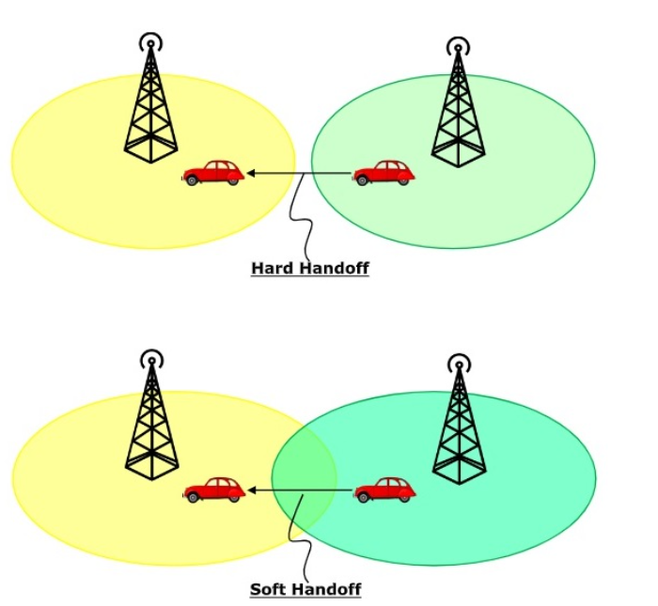
Types of Handoff
Hard Handoff − In a hard handoff, an actual break in the connection occurs while switching from one cell to another. The radio links from the mobile station to the existing cell is broken before establishing a link with the next cell. It is generally an inter-frequency handoff. It is a “break before make” policy.
Soft Handoff − In soft handoff, at least one of the links is kept when radio links are added and removed to the mobile station. This ensures that during the handoff, no break occurs. This is generally adopted in co-located sites. It is a “make before break” policy.

Slide 51
Mobile Assisted Handoff
Mobile Assisted Handoff (MAHO) is a technique in which the mobile devices assist the Base Station Controller (BSC) to transfer a call to another BSC. It is used in GSM cellular networks. In other systems, like AMPS, a handoff is solely the job of the BSC and the Mobile Switching Centre (MSC), without any participation of the mobile device.

Slide 52
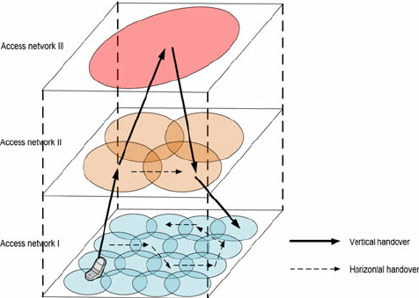
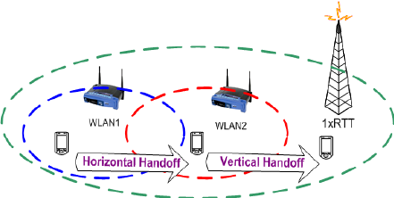
Handoff Types
Depending on the movement of the mobile device, it may undergo various types of handoff. In a broad sense, handoffs may be of two types: (i) intra-system handoff (horizontal handoff) and (ii) inter-system handoff (vertical handoff).
Handover within same access networks (e.g., WLAN-to-WLAN) is referred to as horizontal handover or intra-domain handover,
Handover across heterogeneous access networks (e.g., GSM-to- WiMAX) is referred to as the vertical or Inter-domain handover.

Slide 53
Factors Influencing Handoffs
Transmitted power: as we know that the transmission power is different for different cells, the handoff threshold or the power margin varies from cell to cell.
Received power: the received power mostly depends on the Line of Sight (LoS) path between the user and the BS. Especially when the user is on the boundary of the two cells, the LoS path plays a critical role in handoffs and therefore the power margin depends on the minimum received power value from cell to cell.
Area and shape of the cell: Apart from the power levels, the cell structure also a plays an important role in the handoff process.
Mobility of users: The number of mobile users entering or going out of a particular cell, also fixes the handoff strategy of a cell.

